Slide 1
Telecommunications and Network Security or wow, this is a long chapter
IS 380

Slide 2
Telecommunications
The electrical transmission of data among systems.

Slide 3
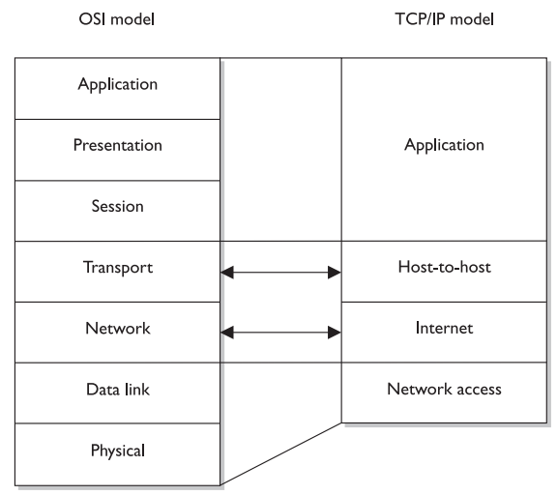
OSI v.s. TCP/IP

Slide 4
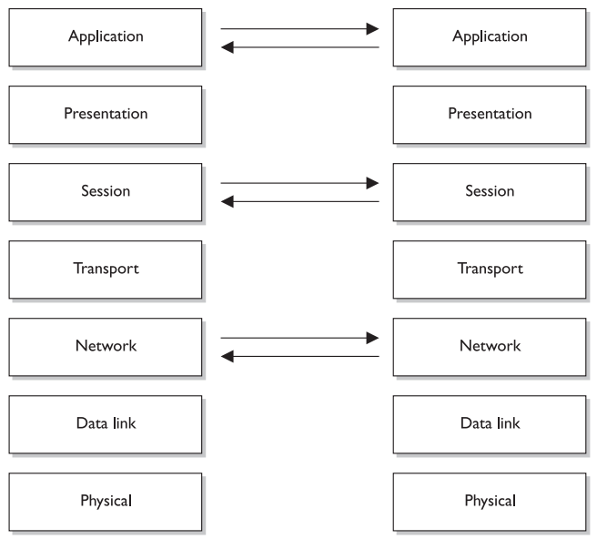
Encapsulation
Notes:
P487

Slide 5
Application
Closest to end user
File transmissions, message exchange, etc.
SMTP, HTTP, FTP, SNMP, TFTP, Telnet
PDU - message
Notes:
p489

Slide 6
Presentation
Formats information so the computer (application) can understand it.
TIFF/JPEG/BMP
ASCII/EBCDIC
MPEG/MIDI
Compression and encryption
Notes:
P490

Slide 7
Session
Establishing connections between applications
Maintaining & terminating connection
NFS, SQL, RPC, NetBIOS
Modes
Simplex, half duplex, full-duplex
Notes:
P491

Slide 8
Transport
Communication between computers
End-to-end data transport
TCP, UDP, SSL*, TLS, SPX
Reliable/unreliable transport
PDU – segment or packet
Notes:
p494

Slide 9
Network
Addressing and routing
IP, ICMP, IGMP, RIP, OSPF, IPX
PDU - datagram

Slide 10
Data Link
LAN/WAN
Token Ring, Ethernet, ATM, FDDI
LLC – Talks to network layer (802.2)
MAC – Talks to physical layer (802.3, 802.11, etc)
SLIP, PPP, L2TP, ARP, RARP
The ‘bits’
PDU - frame
Notes:
FDDI = fiber distributed data interface

Slide 11
Physical
Encodes bits into electrical signals
Synchronization, data rates, line noise, timing.
HSSI, X.21, EIT/TIA-232, EIA/TIA-449

Slide 12
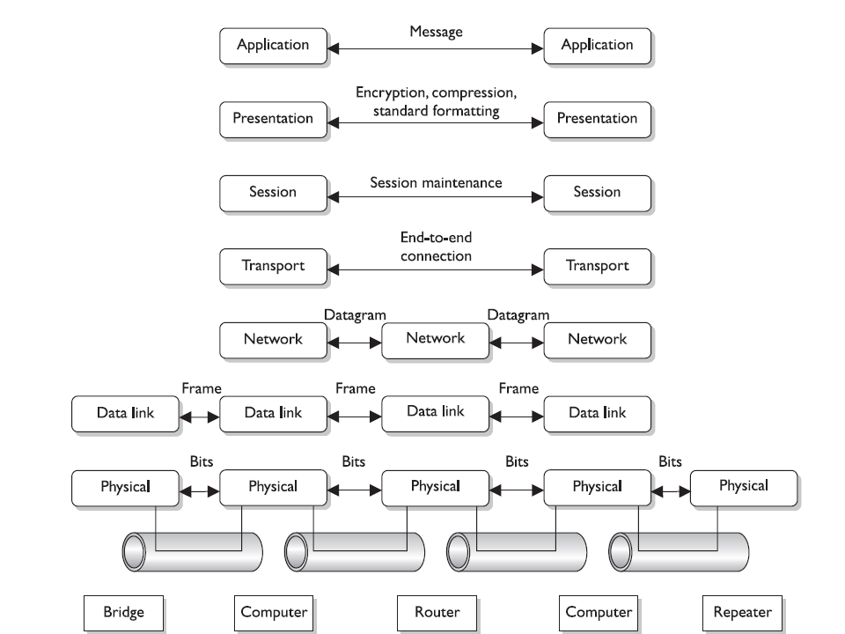
Notes:
P499

Slide 13
TCP/IP
IP – Provides addressing and routing, connectionless protocol
TCP – Connection oriented, requires a source and destination port
Reliable.
Lots of overhead (30%+)
UDP – Connectionless (src and dst ports)
best effort
Low overhead
Notes:
P500

Slide 14
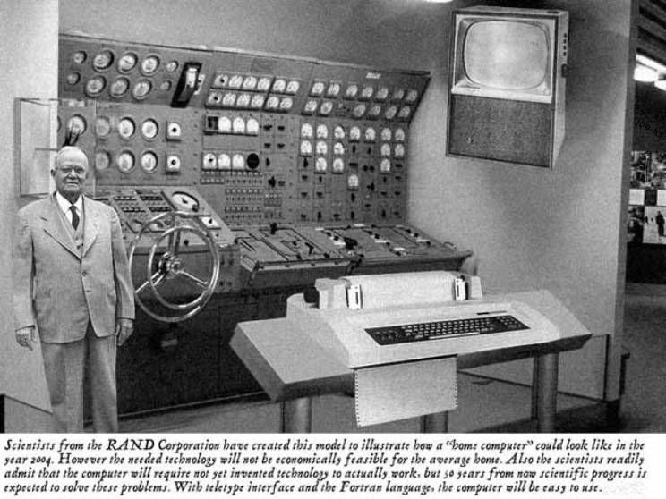
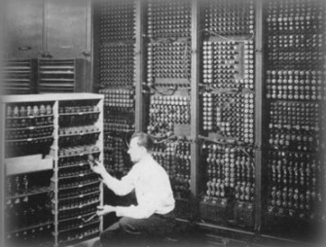
TCP ‘3-way’ handshake
SYN
SYN/ACK
ACK
Notes:
P504

Slide 15
Ports & sockets
Ports up to 1023 are well known – they have de facto services that run on them
Application automatically connect to the expected port – i.e. Internet Explorer connects to port 80
Socket – source and destination address and ports.

Slide 16
In Class Lab
Run netstat
What connections are currently open?
What options are available in netstat?
What protocols are being used?

Slide 17
In Class Lab (Cont)
Run Wireshark
Log into webmail
Do a text string search

Slide 18
IPv6 - IPng
Eliminates need for NAT, however NAT has reduced the need for IPv6
IPSEC built in
128 bit address
Notes:
P509

Slide 19
Analog and Digital
Analog - EM waves. Modulated – frequency/amplitude.
Sign wave
Digital – electrical pulses.
Square wave

Slide 20
Synchronous & Asynchronous
Asynchronous – no synchronization
Low BW
Stop and start bits
modems
Synchronous – continuous stream, timing
High BW

Slide 21
Baseband & Broadband
Baseband – entire medium – Ethernet
Broadband – divided into channels - CATV
Notes:
P512

Slide 22
LAN networking

Slide 23
Network typology
Notes:
P513

Slide 24
PAN, LAN, CAN, MAN, WAN
PAN – Bluetooth, IrDA, Z-wave, ZigBee
LAN – shared medium, cabling, etc.
Star, Ring, Bus, Tree, Mesh
Ethernet – ‘chatty’ CSMA/CD
Token Ring – token passing 4/16
CAN
MAN
FDDI – counter-rotating ring
Notes:
P517

Slide 25
Cable types
Coax
ThinNet – 10Base2
ThickNet – 10Base5
Twisted-Pair
Shielded twisted pair
Unshielded twisted pair
Cat3, Cat5, Cat6
Fiber-optic
Single-mode & multimode
Notes:
p524

Slide 26
Problems with cabling
Noise
Crosstalk
EMI/RFI
Attenuation - The higher the frequency. . .
cable length
UTP –100m or 300’, ThinNet 185m
Security (Fiber, coax, STP, UTP)
Fire Rating – PVC VS fluoropolymer

Slide 27
Token ring
24-bit token
Data placed and removed from token by the same device.
Multiple tokens?
Notes:
P530

Slide 28
CSMA
CSMA/CD Carrier sense Multiple access with collision detection.
CSMA/CA Carrier sense Multiple access with collision detection (WiFi)
Carrier, Contention, Collision, Back-off algorithm.
Broadcast domain
Collision domain
Notes:
P531

Slide 29
IP protocols - security
ARP – spoofing
DHCP – rogue server
ICMP – ‘Loki’ – backdoor channel
DOS:
SYN flood

Slide 30
Routing protocols
AS - Autonomous System
Dynamic Routing protocol
Distance vector - # of hops
RIP, IGRP (5 criteria)
Link state – hops, size, speed, delay, load, etc. Calculate a typology. ^CPU ^RAM
OSPF
Static Routing protocol
Route flapping
BGP
Notes:
P539

Slide 31
Network devices

Slide 32
Network Devices
Repeaters – L1
hub
Bridges – L2
STA/STP
Switches ‘multiport bridge’

Slide 33
Network Hardware - Switches
Creates a private link between the destination and source
Prevents network sniffing
Allows for the creations of VLANS – physical proximity not required
VLANS allow greater resource control
L3/L4 Switches – application specific integrated circuit. Tagging/MPLS/QoS

Slide 34
Network hardware - Routers
Layer 3
Connect 2 or more networks
Traffic flow can be controlled by protocol, source address, destination address, or port number
Forwards broadcast data to an entire network

Slide 35
Network Hardware - Gateways
Acts as a translator for unrelated environments
Can connect different protocols (IPX to TCP) or link technologies (Token Ring to Ethernet)
Most common example is a mail gateway that formats and forwards SMTP mail
Layer 7 (L3+)
Network Access Server
PBX provides telephone switching

Slide 36
Firewalls
Provide a “Choke point” in the network
Types:
Packet Filtering
Stateful inspection
Proxy
Dynamic packet filtering
Kernel proxy
DMZ ‘firewall sandwich’ vs. Filtered Subnet
Notes:
P554

Slide 37
Firewalls – Packet Filtering
Based on a ruleset, or ACL – layer 3 info
Can access a limited amount of data about a packet (source, dest, protocol)
Not too smart = fast processing
Vulnerable to DoS attacks, spoofing, malicious data
1st generation Firewalls
Notes:
P553

Slide 38
Firewalls – Stateful inspection
Keeps track of connections in state table
Example – Will defend against a Syn flood
Allows for more complicated rules, such as only allowing responding traffic for a protocol
Require higher overhead – makes them vulnerable to DoS attacks
3rd generation
Notes:
P556

Slide 39
Firewalls - Proxy
Acts as the client for all connections
Outsiders only ever see the IP address for the firewall
Repackages all packets
May impact functionality in client-server model
2nd generation firewalls

Slide 40
Proxy types
Application-Level – understand each protocol (Layer 7)
less flexible
more granular
One proxy per protocol/Service
Protect from spoofing, sophisticated attacks.
Circuit-Level – session layer. More flexible
SOCKS

Slide 41
Dynamic Packet Filtering FW
0-1023 well known ports
Allows to permit anything outbound and permit response only traffic.
ACLs built as client establishes outbound connections
UDP connections simply time out.
4th generation

Slide 42
Kernel Proxy Firewall
Virtual network stack dynamically created for each packet
Inspection happens in kernel - fast
Packet scrutinized at all layers
Proxy-based system
5th generation Firewall
Notes:
P563

Slide 43
Firewall best practices
Block oddball ICMP (redirect, etc).
No source routing
Block directed broadcasts
Block ingress packets with internal or RFC1918 addresses. (spoofing)
Disable anything unused (default deny)
Look at logs.

Slide 44
Firewall Architectures
Bastion Host – Directly connected to the Internet or DMZ, must be carefully hardened
Dual-Homed or Multi-Homed FW – Multiple NICs, connects internal and external networks
Screened host – router scans traffic before it goes to a firewall.
Screened Subnet – The area between the router and the first firewall, or the area between the firewalls. (I disagree)
Notes:
P565

Slide 45
DNS
Domain Name Service 1992 NSF; ‘hosts’
URL – Uniform Resource Locator
FQDN – Fully Qualified Domain name
Zones,
Root, TLD – inverse tree.
Authoritative server. Primary and 2ndary.
Zone transfer
Resource records
Recursion

Slide 46
DNS issues
DNS cache poisoning (race condition)
No authentication
DNSSEC and authentication (PKI). 2011
Hosts file and malware
Split DNS (corporate security)
Cyber squatters
Notes:
P577

Slide 47
Directory Services
Hierarchical database
Classes, objects, schema, ACLs
Active Directory
Novell Directory Services
OpenLDAP
LDAP – Lightweight Directory Access Protocol

Slide 48
NAT
RFC 1918 addresses
Short term fix to address depletion
Hides typology
Static mapping – one to one translation
Dynamic mapping – dynamic pool
PAT – many to one
Delayed the need for IPv6
Notes:
P580

Slide 49
Intranet/Extranet
Intranet
Web-based application accessible from inside the company network
Extranets
usually B2B
EDI - Electronic Data Interchange
Dedicated link?

Slide 50
Local area networks in visio
In class lab

Slide 51
Wide area networks

Slide 52
MAN
Metropolitan Area Network
SONET – Synchronous Optical Network
Redundant ring
Local and regional rings
FDDI
Notes:
p585

Slide 53
WAN
MUX – multiplexing
SONET (US) & SDH (everyone else)
Synchronous Digital Hierarchy
ATM – Asynchronous Transfer Mode
Dedicated Links / Leased Lines
Notes:
p586

Slide 54
WAN cont
CSU/DSU – Channel Service Unit/Data Service Unit
Circuit Switching – one set path. Voice.
Packet Switching – multiple possible paths
Frame Relay – shared bandwidth
CIR – committed information rate
PVC – guaranteed BW (CIR)
SVC – teleconferencing, temporary remote site conn., voice calls.

Slide 55
ATM
LAN, MAN, WAN
Cell switching
Connection oriented
53-byte cells

Slide 56
QoS
ATM
CBR – constant bit rate, voice/video -conn
VBR – delay-insensitive – conn
UBR – unspecified – no control of data rate. Connectionless
ABR – available - guaranteed BW + leftover, conn
Notes:
P599

Slide 57
QoS non-ATM
Best-effort – actually the lowest QoS
Differentiated – middle-tier
Guaranteed service – High QoS: Voice/Video.

Slide 58
Multiservice Access Technology
PSTN – public-switched telephone network
SS7 Signaling System 7
Circuit-based
VoIP – Voice over IP
SIP
Packet based
Jitter
Notes:
P602

Slide 59
VoIP
H.323 – ITU-T standard – voice and video.
Terminals, gateways, gatekeepers
VoATM, VoFR – connection-oriented, less jitter.

Slide 60
VoIP - SIP
SIP – Session Initiation Protocol
UAC – User Agent Client – soft phone
UAS – User Agent Server – routing & signaling
RTP – Real-time Transport – handle actual call
Proxy – relay packets in network UAC & UAS
Registrar – central record of everyone’s location on the local network.
Redirect – keep identity while roaming (Enables intra-organizational routes)
Notes:
P605

Slide 61
SiP In Action

Slide 62
SIP issues
Not encrypted
Interception and all other network security issues

Slide 63
Remote Access
Notes:
P610

Slide 64
Dial-up and RAS
RAS server & RADIUS
PTSN network, Modem
Use of callbacks
Wardialing
56K
MLPPP – >56k

Slide 65
ISDN
Integrated Services Digital Network
Digital local loop
Point to point, on demand, fast call setup
BRI -Basic Rate Interface 2B 1D, 144Kbps
PRI -Primary Rate Interface 23B 1D 1.544Mbps (T1)
DDR Demand Dial Routing
backup, expense, timeouts

Slide 66
DSL
Digital Subscriber Line
2.5Mi from pop (18,000’)
52Mbps max
High and low frequency
SDSL – expensive, businesses
ADSL – what you use

Slide 67
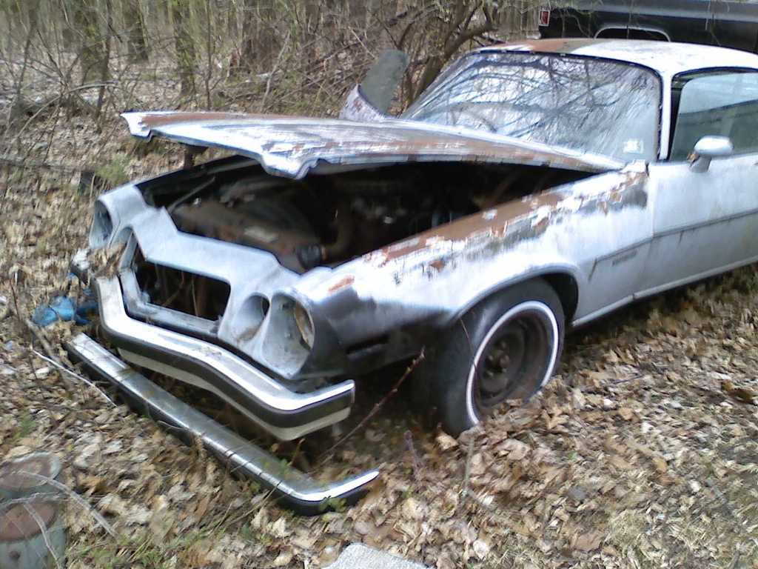
Cable Modems
50Mbps – shared
Requires ‘two way’ network
Reserved channels
DOCSYS
unencrypted

Slide 68
VPN
Virtual Private Network
Private – encrypted. . . ?
3 kinds: IPSec, PPTP, L2TP
Remote users or remote networks
Encapsulation VS encryption
Notes:
P615

Slide 69
PPTP
Must be on IP network
PPP tunnel can contain other protocols
Optional encryption - MPPE

Slide 70
L2TP
Works on more than IP networks
No encryption
Use IPSEC (ESP) with L2TP
Supports RADIUS, TACACS+

Slide 71
Authentication Protocols
PAP – Password Authentication Protocol
Cleartext
CHAP – Challenge Handshake Authentication Protocol – encrypt string
MS-CHAP, MS-CHAPv2
EAP – Extensible Authentication Protocol
Framework for many kinds of authentication
OTP, smart cards, biometrics, etc.
Notes:
P621

Slide 72
Remote Access Summary
Use a firewall – only allow necessary ports to remote users.
Split tunneling problem.
Security of ‘home’ computers
End users: look at SSL VPN instead of PPTP or L2TP.
Notes:
P623

Slide 73
Wireless Communications

Slide 74
Wireless - A Few Details
Frequency vs. Amplitude
Higher frequency: more data, shorter distance.
CSMA/CA – initial broadcast
Spread Spectrum – several frequencies at the same time.

Slide 75
Spread Spectrum
FHSS – Frequency Hopping 802.11 (1-2M)
Splits channel into Sub channels
Hops between them ‘hop sequence’
Reduces interference, can be fairly secure
DSSS – Direct Sequence 802.11b, GPS.
Uses all available BW.
Chips - Added pseudorandom noise at sub-bit level
Looks like white noise
Notes:
P625

Slide 76
Spread Spectrum - Other(cont)
OFDM – Orthogonal Frequency-Division Multiplexing. 802.11a,g,n, ADSL, WiMAX
Many slowly-modulated narrow narrowband signals perpendicular to each other.
Low issues with multipath, attenuation
Notes:
http://en.wikipedia.org/wiki/OFDM
http://www.iec.org/online/tutorials/ofdm/index.asp

Slide 77
That whole 802.11 thing
802.11 – 1997 1-2Mbps 2.4GHz
802.11b – DSSS 11Mbps 2.4GHz
802.11a – OFDM 54Mbps 5GHz (h Europe)
Shorter range, less crowded
802.11g – 54Mbps, 2.4GHz
802.11i – security, authentication

Slide 78
Wireless (802.11b,g,a,n)
AP act as beacons
Modes
Infrastructure – connected to LAN
Stand-alone – wireless hub
Ad hoc – no APs, P2P mode
Service Set ID (SSID)

Slide 79
Wireless Authentication - old
OSA – Open system authentication (SSID)
Clear-text communication
SKA – Shared Key Authentication
WEP
RC4 is symmetric – i.e. fixed shared key
Initialization vector (IV) bad (reuse,↓ randomness)
No packet integrity assurance – hackers can mess with ICVs making the integrity look ok
(Integrity check value)

Slide 80
Wireless Auditing tools
AirSnort
WepCrack
Aircrack-ng
coWPAtty
back|track

Slide 81
Wireless Authentication - new
WEP is broken
Temporal Key Integrity Protocol – some help with weak IV. Still RC4-based.
802.11i WPA, WPA2
Use AES, not TKIP.
EAP-TLS requires certificates
Higher CPU, not backward compatible.

Slide 82
802.11i – AES
CCM Protocol (CCMP) – better encryption at lower layer
802.1X – port-based network access control. (L2)
No network communication until authenticated.
User authentication not system authentication
With EAP - Mutual authentication possible
Authentication server (RADIUS)
Notes:
P633

Slide 83
Wireless security
Use 802.11i/WPA2 enterprise (no PSK)
VPNs (put AP on DMZ)
Lower power/AP placement
MAC filtering
Test security

Slide 84
802.16 - WiMax
“last mile access”
Baltimore – Sprint, Clearwire (Xohm)
Compete with DSL/cable

Slide 86
Cell phone security
Cloning
Cameras
Enterprise connectivity/data on phone
APN
Security policies

Slide 87
Malware
RootKits
Spyware/Adware
Email Spoofing
Instant messaging
SPIM
Corporate IM

Slide 88
Other technologies to consider
IDS/IPS
Honeypots
SSL VPN
Notes:
p582

Slide 89
In Class Lab
Network diagrams with MS Visio

